Slide 1

unpackAI -
Review Session

Slide 2
We studied Recommender System…
What were your findings?
What did you struggle with?
Notes:
Only allow graduates of DL 101 to join the Slack channel to guarantee an active channel? (seems like a stupid idea but I wanted to put an online communication tool here.)

Slide 3
We all saw the results of our Recommendations System, but…
How do we evaluate the results?
Notes:
Only allow graduates of DL 101 to join the Slack channel to guarantee an active channel? (seems like a stupid idea but I wanted to put an online communication tool here.)

Slide 4
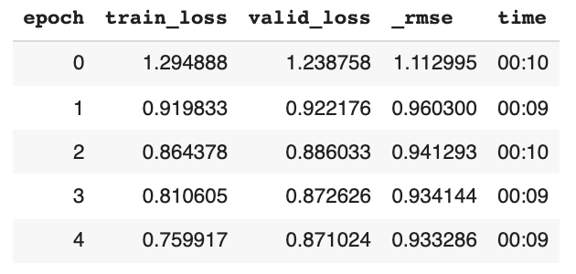
Evaluation of a recommender system
Metrics based evaluation
Root mean squared error (RMSE) indicates how spread out the data is around the line of best fit.
The lower the better. RMSE value between 0.2 and 0.5 shows that the model can relatively predict the data accurately.
Notes:
Only allow graduates of DL 101 to join the Slack channel to guarantee an active channel? (seems like a stupid idea but I wanted to put an online communication tool here.)

Slide 5
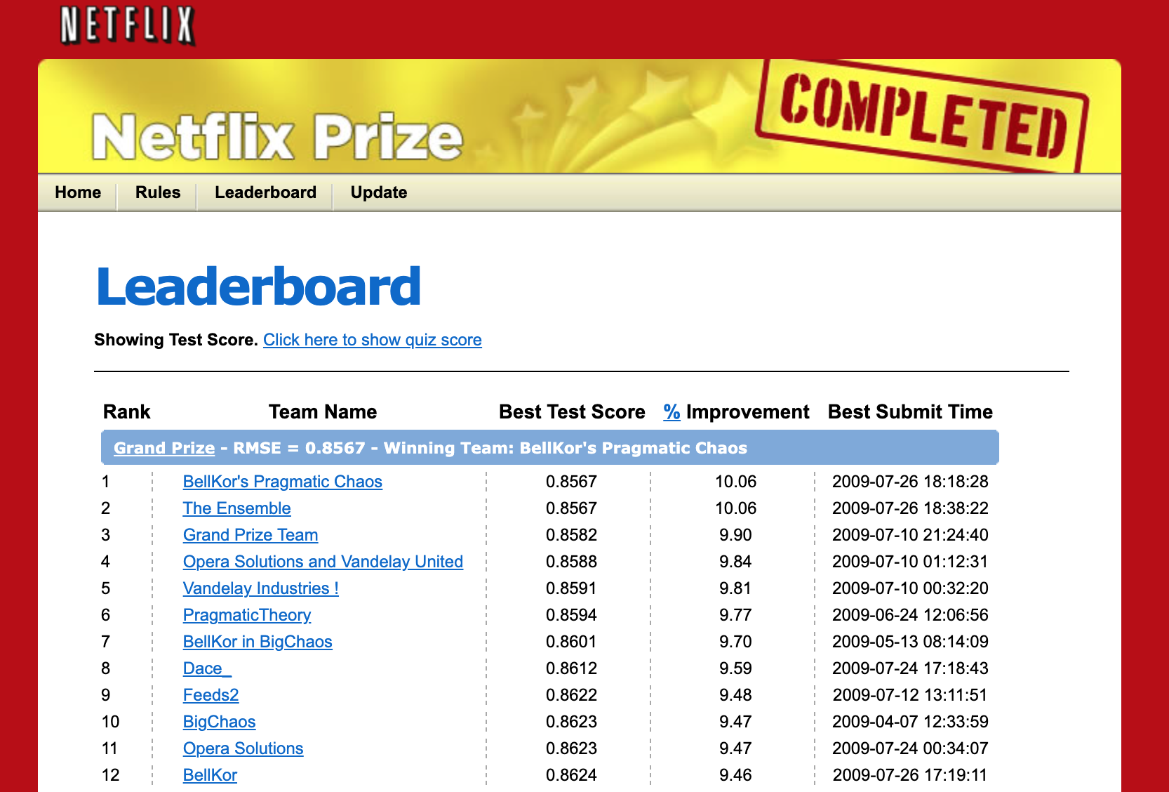
Evaluation of a recommender system
Netflix Prize
The Netflix Prize was an open competition for the best collaborative filtering algorithm to predict user ratings for films, based on previous ratings without any other information about the users or films.
Notes:
Only allow graduates of DL 101 to join the Slack channel to guarantee an active channel? (seems like a stupid idea but I wanted to put an online communication tool here.)

Slide 6
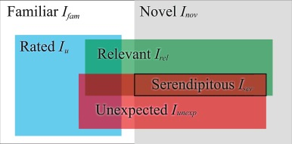
Evaluation of a recommender system
Human based evaluation - Serendipity
1. Check for the side effects such as having users stuck in an “information confinement area” (= only provide recommendations for items extremely close to the one they already like).
—> Recommendation systems should allow users to explore and find items they like they would otherwise not have known about.
Serendipity: computing the distance between recommended items in the embedding space.
Notes:
For example, instead of recommending a user “Start Wars” 1, 2 and 3, it seems better to recommend “Star wars 1”, “Start trek into darkness” and “Indiana Jones and the raiders of the lost ark”: the two later may be seen by our system as having less chance to interest our user but recommending 3 items that look too similar is not a good option.

Slide 7
Evaluation of a recommender system
Human based evaluation - Serendipity
The role of bias:
Some items (i.e. movies) can be so popular that even though the latent factors do not match the preferences of a user, they would still be recommended because they are liked by anyone.
—> Bias has a very high value.
Oppositely, some can be so unpopular that they would rarely be recommended.
—> Bias has a very low value.
See the example with anime!

Slide 8
Evaluation of a recommender system
Human based evaluation
Explainability: If users do not understand why they had been recommended as specific item, they tend to loose confidence into the recommender system.
How to know if a new recommendation is relevant before actually recommending it to our user?
Actions taken: A/B testing approach, how many users purchased/watched more products/movies using which recommendation system.
Notes:
For example, instead of recommending a user “Start Wars” 1, 2 and 3, it seems better to recommend “Star wars 1”, “Start trek into darkness” and “Indiana Jones and the raiders of the lost ark”: the two later may be seen by our system as having less chance to interest our user but recommending 3 items that look too similar is not a good option.

Slide 9
Open Questions
How to get around the risk of a cold start for a collaborative filtering recommender system?
What is the advantage of a collaborative filtering system over a content-based filtering recommender system?
Where could you imagine to use Recommender Systems? Which one have you experienced and how was your experience?
Notes:
For example, instead of recommending a user “Start Wars” 1, 2 and 3, it seems better to recommend “Star wars 1”, “Start trek into darkness” and “Indiana Jones and the raiders of the lost ark”: the two later may be seen by our system as having less chance to interest our user but recommending 3 items that look too similar is not a good option.

Slide 10
Thanks for joining!

